Slide 1


What You'll Learn

Slide 2
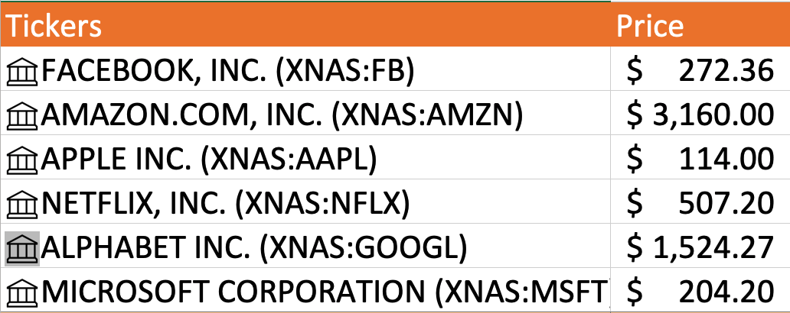
1. Pull in Stock Data

Slide 3
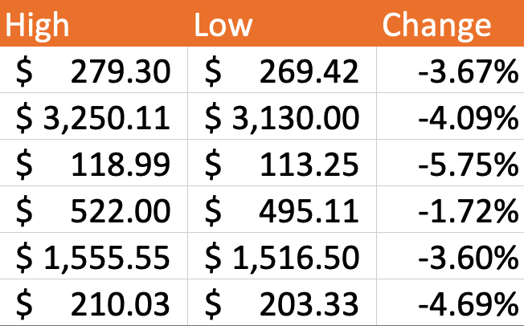
2. Pull in More Stock Information

Slide 4
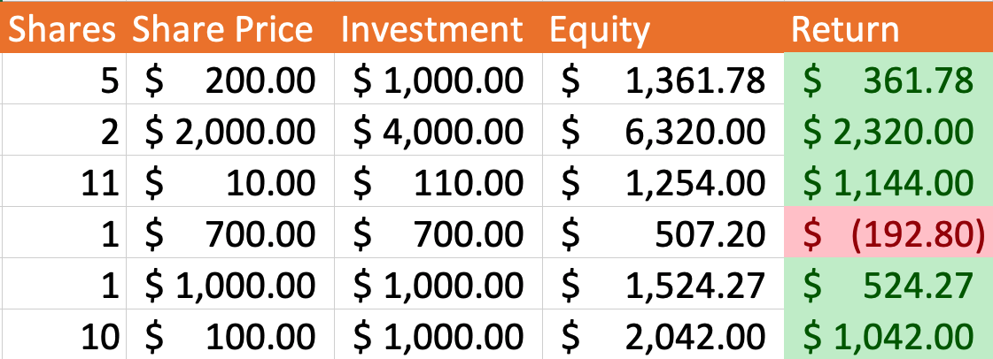
3. Calculate Equity and Returns

Slide 5
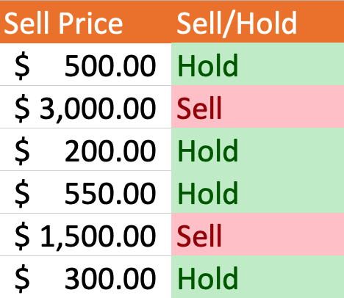
4. Calculate Selling Strategy

Slide 6
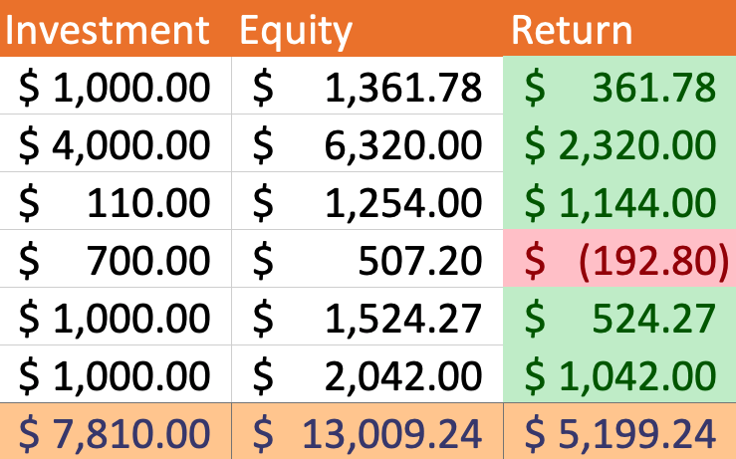
5. Calculate Total Returns

Slide 7
What You'll Learn ✓
Let’s begin...

